Slide 1
Chapter 3: Processes
Part Two: Process Management

Slide 2
Outline
Process Concept
Process Scheduling
Operations on Processes
Interprocess Communication
IPC in Shared-Memory Systems
IPC in Message-Passing Systems
Examples of IPC Systems
Communication in Client-Server Systems

Slide 3
Process
A word processor is a processor,
A web browser (web page) is a processor,
And an email package.

Slide 4
CHAPTER OBJECTIVES
Identify the separate components of a process and illustrate how they are represented and scheduled in an operating system.
Describe how processes are created and terminated in an operating system, including developing programs using the appropriate system calls that perform these operations.
Describe and contrast interprocess communication using shared memory and message passing.
Design programs that use pipes and POSIX shared memory to perform interprocess communication.
Describe client–server communication using sockets and remote procedure calls.
Design kernel modules that interact with the Linux operating system.

Slide 5
PROCESS
A process is an instance of a computer program that is being executed.
A program becomes a process when an executable file is loaded into memory.
Operating systems have many background tasks running, your computer is likely to have many more processes running than actual programs.

Slide 6
PROCESS (CONT.)
For example;
You may only have three programs running, but there may be (twenty) active processes.
You can view active processes in Windows by opening the Task Manager (press Ctrl-Alt-Delete and click Task Manager).

Slide 7
PASSIVE ENTITY & ACTIVE ENTITY
File containing list of instructions stored on disk (often called executable file) called passive entity.
A process is an active entity, with a program counter specifying the next instruction to execute and a set of resources.

Slide 8
Processes
A process is a program in execution.
Program
Description of how to perform an activity Instructions and static data values
Process
A snapshot of a program in execution.
Memory
(Instructions, Data, Runtime Stack)
CPU state (Registers, PC, SP, etc.)
Operating system state
(open files, accounting statistics, etc.)

Slide 9
Virtual Address Space
or “Logical” Address Space
Each process runs in its own virtual memory address space
Which consists of...
Text – the program code (usually read-only)
Data space – variables (initialized/uninitialized)
Stack space – used for function calls
stack
Address space
data
text
... Results in the creation of multiple, distinct address spaces. ₄
Invoke the same program multiple times?

Slide 10
Process Switching
In its simplest form, a computer performs instructions on operands. Registers are used to hold values temporarily to speed things up.
Memory
CPU
Program Code
ALU
Program Data
Regs
SP
PC

Slide 11
Process Switching
In its simplest form, a computer performs instructions on operands. Registers are used to hold values temporarily to speed things up.
Program 1 is running
Memory
CPU
ADD R1, R2
Program Code
ALU
Program Data
Regs
SP
PC

Slide 12
Process Switching
Saving all the information about a process allows a process to be temporarily suspended.
Memory
CPU
Program Code
ALU
Program Data
Regs
SP
PC

Slide 13
Process Switching
Saving all the information about a process allows a process to be temporarily suspended.
Memory
CPU
Program Code
ALU
Program Data
Regs
SP
PC
Program
Save the state of program 1
State

Slide 14
Process Switching
Saving all the information about a process allows a process to be temporarily suspended.
Program 2 now has the CPU
Memory
CPU
SUB R3, R4
Program Code
Program Code
ALU
Program Data
Program Data
Regs
SP
PC
Program State

Slide 15
Process Switching
Saving all the information about a process allows a process to be temporarily suspended.
Memory
CPU
Program Code
Program Code
ALU
Program Data
Program Data
Regs
SP
PC
Program State
Program State
Save the state of program 2

Slide 16
Process Switching
Saving all the information about a process allows a process to be temporarily suspended.
Memory
CPU
Program Code
Program Code
ALU
Program Data
Program Data
Regs
SP
PC
Program State
Program State
Restore the state of
program 2

Slide 17
Process Switching
Saving all the information about a process allows a process to be temporarily suspended.
Program 1 has the CPU
Memory
CPU
ADD R5, R6
Program Code
Program Code
ALU
Program Data
Program Data
Regs
SP
PC
Program State
Program State

Slide 18
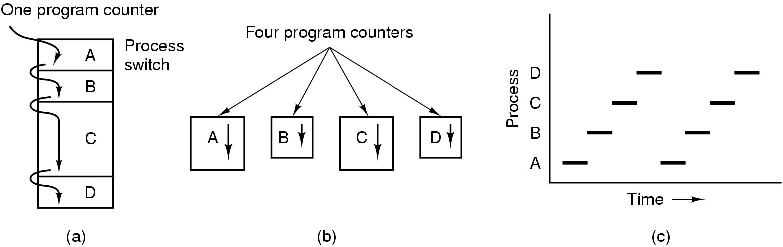
Why use the process abstraction?
Multiprogramming of four programs in the same address space
Conceptual model of 4 independent, sequential processes
Only one program is active at any instant

Slide 19
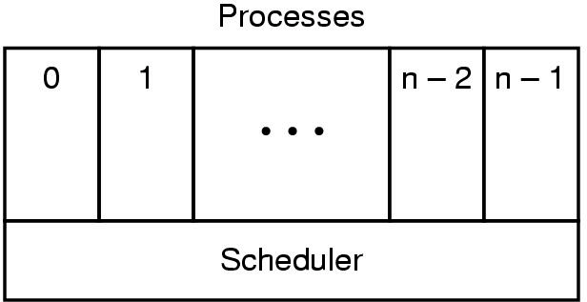
The Role of the Scheduler
Lowest layer of process-structured OS
handles interrupts & scheduling of processes
Above that layer are sequential processes

Slide 20
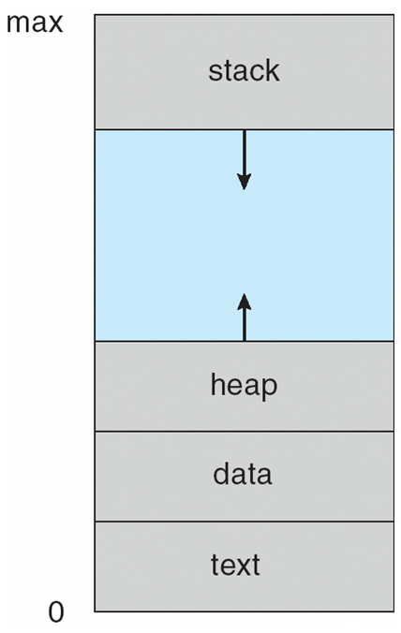
PROCESS IN MEMORY
Figure 3.1 Layout of a process in memory.
A PROCESS GENERALLY INCLUDES

Slide 21
A PROCESS GENERALLY INCLUDES
1. Process Stack
A process stack contain temporary data (such as function parameters, return addresses and local variables)
2. Data Section
The data section contains global variables.
3. Heap
A heap is a memory, that is dynamically allocated during process run time.
4. Text Section
Contains program code.

Slide 22
PROCESS STATES
As a process executes, it changes state. Each process may be in one of the following states.
New
The process is being created.
Running
Instructions are being executed.
Waiting
The process is waiting for some event to occur( such as an I/O completion or reception of a signal).
Ready
The process is waiting to be assigned to a processor.
Terminated
The process has finished execution.

Slide 23
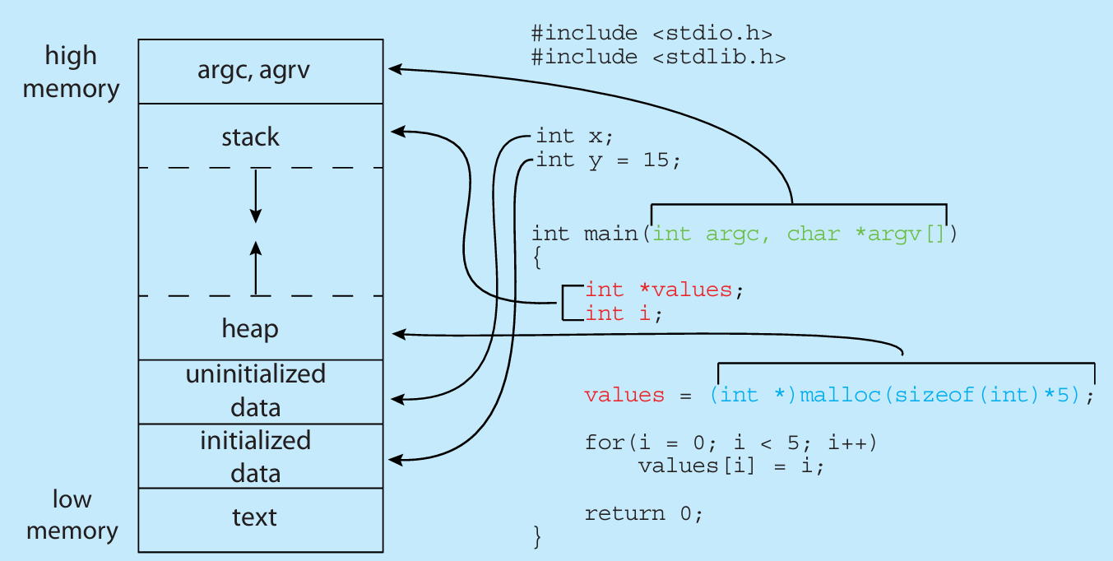
MEMORY LAYOUT OF A C PROGRAM

Slide 24
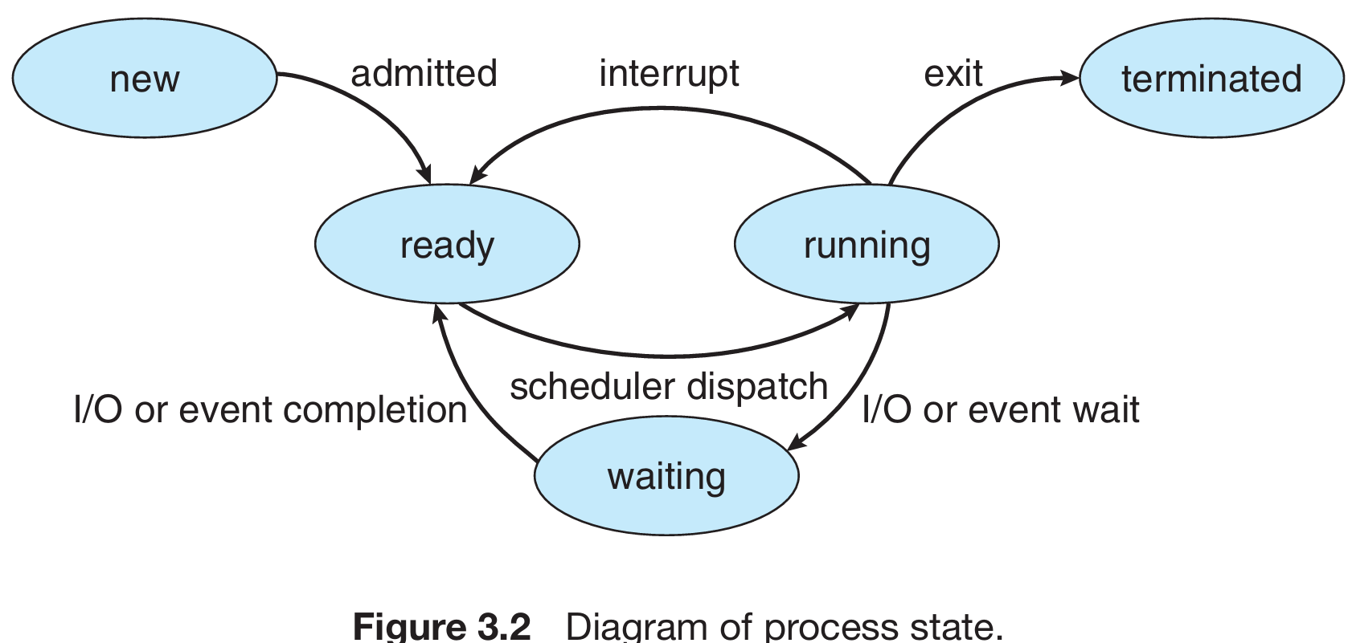
PROCESS STATES DIAGRAM

Slide 25
PROCESS STATES DIAGRAM
These names are arbitrary, and they vary across operating systems. The states that they represent are found on all systems, however. Certain operating systems also more finely delineate process states.
It is important to realize that only one process can be running on any processor core at any instant. Many processes may be ready and waiting.

Slide 26
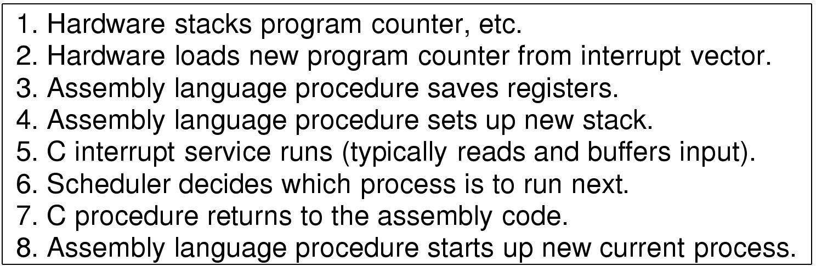
Implementation of process switching
Skeleton of what the lowest levels of the OS do when an interrupt occurs

Slide 27
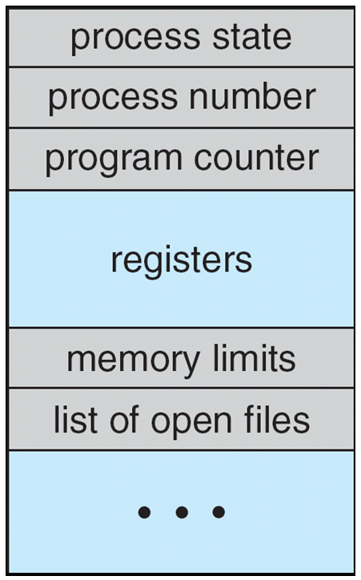
Process Control Block (PCB)
Each process is represented
in Operating System by a
Process Control Block(PCB).
It is also called a
task control block

Slide 28
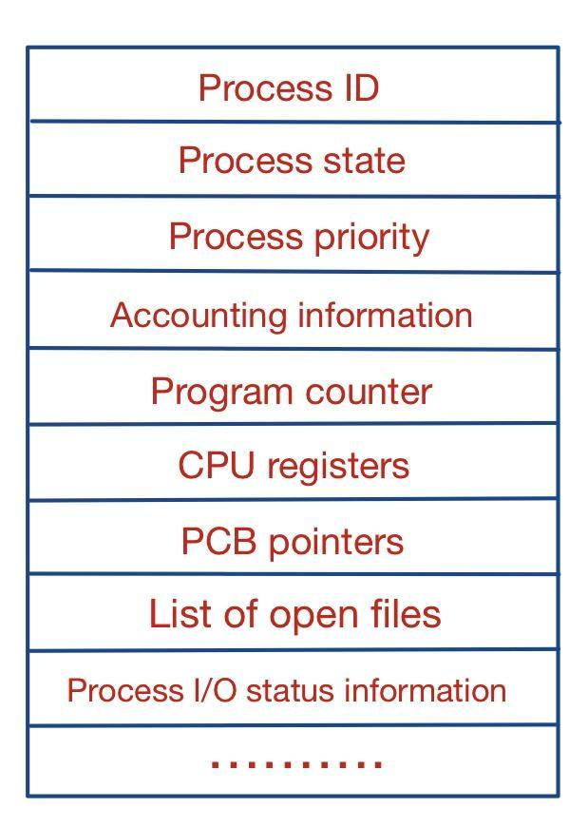
Process Control Block (PCB)

Slide 29
Process Control Block (cont.)
Process state
The state may be new, ready, running,waiting and so on.
Program counter
Program counter indicate the address of the next instruction to be executed for this process.

Slide 30
Process Control Block (cont.)
CPU registers
The registers vary in number and type, depending on the computer architecture.
They include:
Accumulators (i.e an accumulator is a register in which intermediate arithmetic and logic results are stored).
Index registers (i.e index register used for modifying operand addresses during the run of a program).
Stack pointers (The stack pointer is used to give the address of the stack area,where the local variables and parameters to subroutines are stored).
General purpose registers ( i.e general purpose register is a small amount of storage available on the CPU whose contents can be accesses more quickly than storage available elsewhere).

Slide 31
Process Control Block (cont)
CPU-scheduling information
This information includes process priority, pointers to scheduling queues, and any ther scheduling parmeters.
Memory-management information
This include value of the base and limit registers, the page tables, or the segment tables.

Slide 32
Process Control Block (cont)
Accounting information
This information includes the amount of CPU and real time used, time limits, account numbers, job or process numbers and so on.
I/O status information
This includes the list of I/O devices allocated to the process, a list of open files and so on.
In brief, the PCB simply serves as the repository for all the data needed to start, or restart, a process, along with some accounting data.

Slide 33
3.1.4 Threads
So far, process has a single thread of execution
Consider having multiple program counters per process
Multiple locations can execute at once
Multiple threads of control -> threads
Must then have storage for thread details, multiple program counters in PCB
Explore in detail in Chapter 4

Slide 34
3.1.4 Threads
Traditional processes run as a single thread of execution.
Example: In a word processor, only one task is executed at a time -> Single Thread of Execution:
Limitations of Single Thread:
Users cannot perform multiple tasks simultaneously (e.g., typing and running a spell checker).

Slide 35
3.1.4 Threads
Introduction of Multithreading:
Modern operating systems extend the process concept to include multiple threads of execution. This allows processes to perform more than one task at a time.

Slide 36
3.1.4 Threads
Benefits of Multithreading:
Particularly advantageous in multicore systems, where multiple threads can run in parallel.
Example of Multithreaded Application:
A multithreaded word processor can manage user input in one thread while running the spell checker in another thread.

Slide 37
3.1.4 Threads
Process Control Block (PCB) Changes:
To support multithreading, the Process Control Block (PCB) is expanded to include information for each thread.
System Changes Required:
Additional modifications throughout the system are necessary to support the functionality of threads.
Further Exploration:
Chapter 4 of the referenced material covers threads in detail.

Slide 38
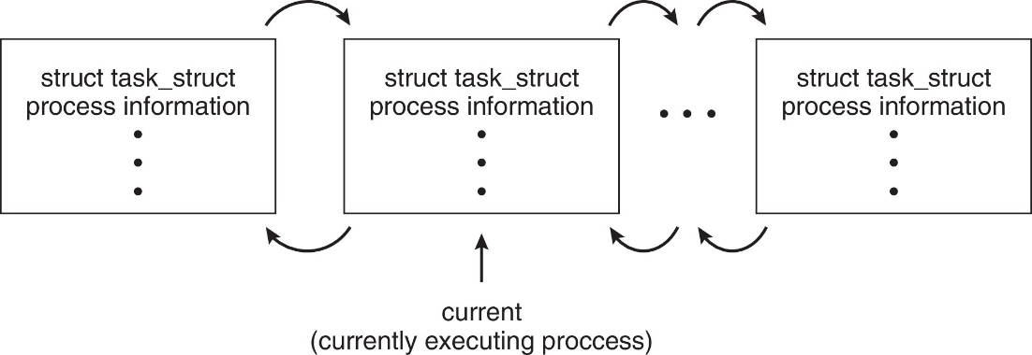
Process Representation in Linux
Represented by the C structure task_struct
pid t_pid; /* process identifier */ long state; /* state of the process */ unsigned int time_slice /* scheduling information */ struct task_struct *parent;/* this process’s parent */ struct list_head children; /* this process’s children */ struct files_struct *files;/* list of open files */ struct mm_struct *mm; /* address space of this process */

Slide 39
Process Scheduling
Process scheduler selects among available processes for next execution on CPU core
Goal -- Maximize CPU use, quickly switch processes onto CPU core
Maintains scheduling queues of processes
Ready queue – set of all processes residing in main memory, ready and waiting to execute
Wait queues – set of processes waiting for an event (i.e., I/O)
Processes migrate among the various queues

Slide 40
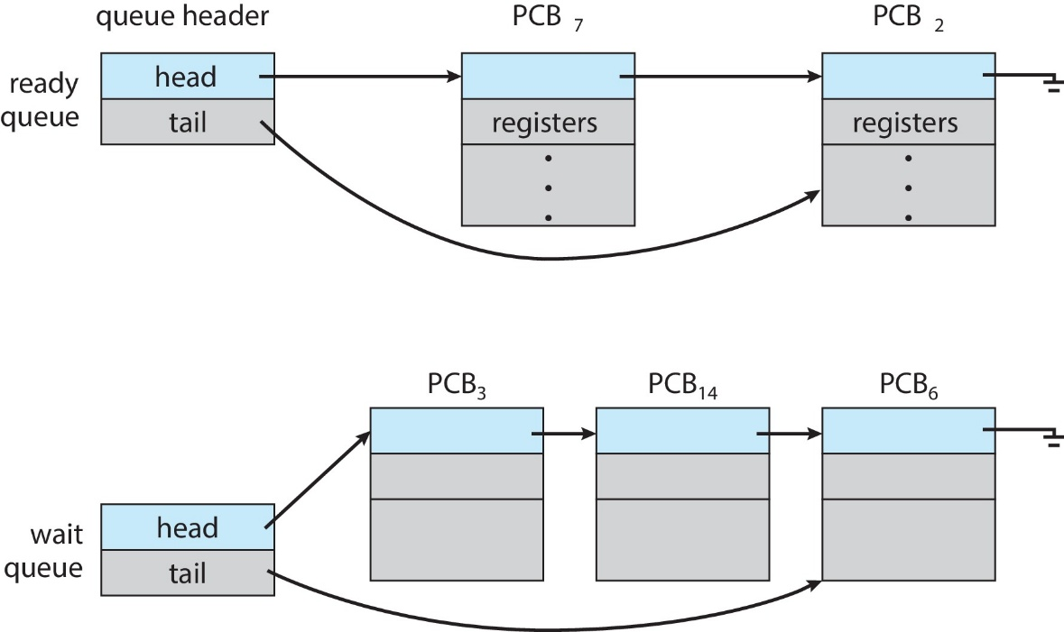
Ready and Wait Queues

Slide 41
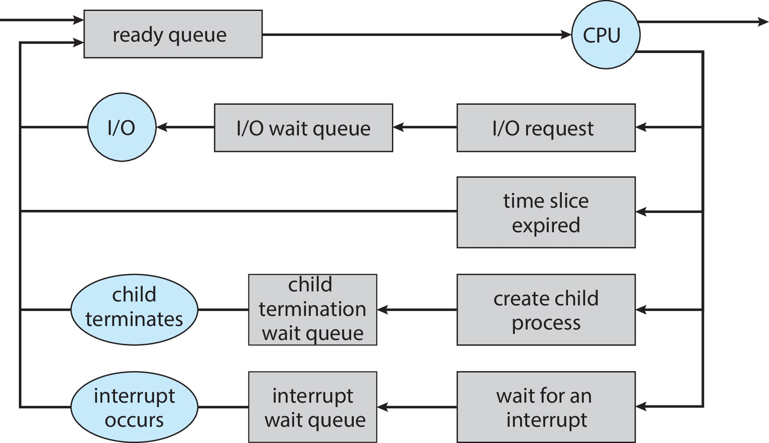
Representation of Process Scheduling

Slide 42
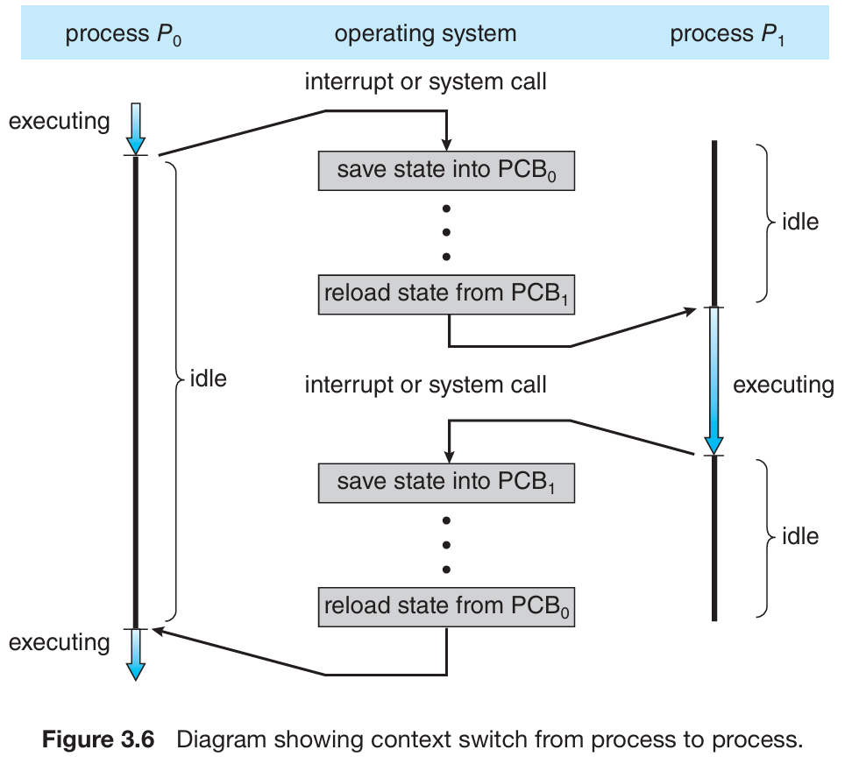
CPU Switch From Process to Process
A context switch occurs when the CPU switches from one process to another.

Slide 43
Context Switch
When CPU switches to another process, the system must save the state of the old process and load the saved state for the new process via a context switch
Context of a process represented in the PCB
Context-switch time is pure overhead; the system does no useful work while switching
The more complex the OS and the PCB ➔ the longer the context switch
Time dependent on hardware support
Some hardware provides multiple sets of registers per CPU ➔ multiple contexts loaded at once

Slide 44
Multitasking in Mobile Systems
Some mobile systems (e.g., early version of iOS) allow only one process to run, others suspended
Due to screen real estate, user interface limits iOS provides for a
Single foreground process- controlled via user interface
Multiple background processes– in memory, running, but not on the display, and with limits
Limits include single, short task, receiving notification of events, specific long-running tasks like audio playback
Android runs foreground and background, with fewer limits
Background process uses a service to perform tasks
Service can keep running even if background process is suspended
Service has no user interface, small memory use

Slide 45
Time Sharing
The objective of time sharing is to;
Switch the CPU among processes so frequently that users can interact with each program while it is running.

Slide 46
Process Scheduler & Process Identifier
Process Scheduler
The purpose of process scheduler is to selects an available process (possibly from a set of several processes) for program executing on the CPU.
Process Identifier (pid)
Process identifier is used to uniquely identify a process.

Slide 47
OPERATIONS ON PROCESSES
There are two main operations that are applied on process.
1. Process Creation
2. Process Termination

Slide 48
PROCESS CREATION
A process may create several new processes, via a create- process system call, during the course of execution.
Parent Process: The creating process is called parent process.
Child process: The new process is called the children of that process.
Generally, process identified and managed via a process identifier (pid)

Slide 49
PROCESS CREATION (cont.)
Resource sharing options
Parent and children share all resources
Children share subset of parent’s resources
Parent and child share no resources
Execution options
Parent and children execute concurrently
Parent waits until children terminate

Slide 50
PROCESS CREATION (cont.)
Each of these new process may inturn create other processes, which forming a tree of processes.

Slide 51
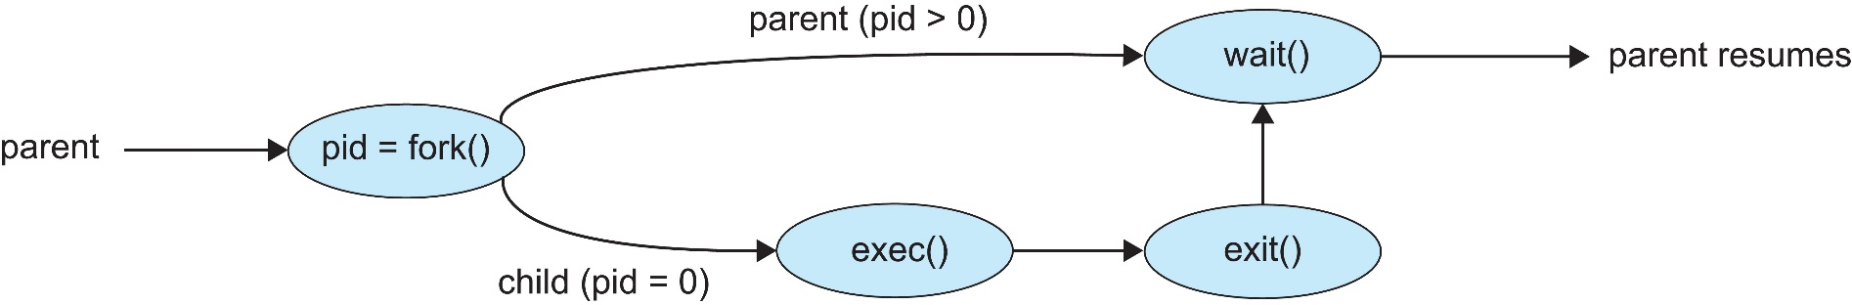
Process Creation (Cont.)
Address space
Child duplicate of parent
Child has a program loaded into it
UNIX examples
fork() system call creates new process
exec() system call used after a fork() to replace the process’ memory space with a new program
Parent process calls wait()waiting for the child to terminate

Slide 52
PROCESS TERMINATION
A process terminate when it finishes executing its final statement and ask the operating system to delete it by using the exit() system call.

Slide 53
PROCESS TERMINATION
Process executes last statement and then asks the operating system to delete it using the exit() system call.
Returns status data from child to parent (via wait())
Process’ resources are deallocated by operating system
Parent may terminate the execution of children processes using the abort() system call. Some reasons for doing so:
Child has exceeded allocated resources
Task assigned to child is no longer required
The parent is exiting, and the operating systems does not allow a child to continue if its parent terminates

Slide 54
PROCESS TERMINATION
Some operating systems do not allow child to exists if its parent has terminated. If a process terminates, then all its children must also be terminated.
cascading termination. All children, grandchildren, etc., are terminated.
The termination is initiated by the operating system.

Slide 55
PROCESS TERMINATION
The parent process may wait for termination of a child process by using the wait()system call. The call returns status information and the pid of the terminated process
pid = wait(&status);
If no parent waiting (did not invoke wait()) process is a zombie
If parent terminated without invoking wait(), process is an orphan

Slide 56
Android Process Importance Hierarchy
Mobile operating systems often have to terminate processes to reclaim system resources such as memory. From most to least important:
Foreground process
Visible process
Service process
Background process
Empty process
Android will begin terminating processes that are least important.

Slide 57
Android Process Importance Hierarchy
Foreground process: The most important process that is currently visible to the user and directly interacts with them, such as an app in use.
Example: A user is actively using a web browser app, scrolling through a website and entering information into a form.

Slide 58
Android Process Importance Hierarchy
Visible process: A process that is not in the foreground but still has a user interface visible to the user, often providing supplementary features to the active foreground app.
Example: A music player app's interface is open, showing the playlist, while another app (like messaging) is currently in the foreground. The music player is visible but not the main focus of user interaction.

Slide 59
Android Process Importance Hierarchy
Service process: A background process that performs long-running operations or tasks that do not require user interaction, often used for tasks like music playback or data syncing.
Example: A GPS navigation app is running in the background to provide turn-by-turn directions while the user is using another app. The GPS service keeps updating location data without requiring direct interaction from the user.

Slide 60
Android Process Importance Hierarchy
Background process: A process that is not currently visible to the user and does not require immediate resources, running tasks that do not need user interaction but can be terminated when resources are needed.
Example: An email app is syncing new messages in the background while the user is using a different app. The user doesn't need to interact with the email app immediately, and it can be killed if system resources are low.

Slide 61
Android Process Importance Hierarchy
Empty process: The least important type of process that has no active components or tasks running; it typically contains no user data or significant operations and can be terminated immediately without consequence.
Example: An application that has been opened once but is not currently running any tasks or holding any data, such as a news app that has been launched but closed immediately without interaction, leaving a placeholder process that can be terminated without impact on user experience.

Slide 62
Week#06 Wednesday’s Lecture

Slide 63
Windows Process Importance Hierarchy
Type of Process | Definition | Example
Foreground Process | Active processes with a visible user interface currently being interacted with by the user. | Microsoft Word while editing a document.
Background Process | Processes running behind the scenes without direct user interaction. | Windows Update downloading updates in the background.
Service Process | Specialized processes that provide essential functions for the OS or applications, often starting automatically. | Print Spooler managing print jobs.

Slide 64
Windows Process Importance Hierarchy
Type of Process | Definition | Example
Batch Process | Processes executing a series of tasks automatically, often scheduled to run without user intervention. | Scheduled backup task running overnight.
Interactive Process | Processes that require user input but may not be the currently focused application. | File download dialog from a web browser.
Zombie Process | Processes that have completed execution but still have an entry in the process table. | A leftover process from a crashed application.
Daemon Process | Background processes performing tasks without user intervention. | Windows Defender scanning for threats.
Console Process | Processes that run within a command-line interface for executing scripts or commands. | Command Prompt running a system maintenance batch file.

Slide 65
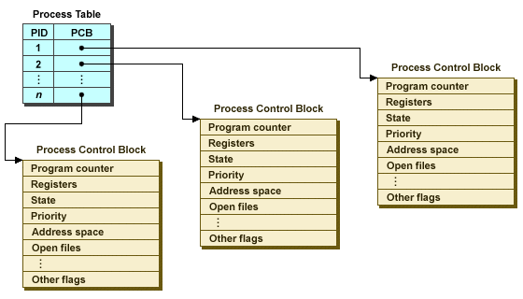
The process table and process control blocks

Slide 66
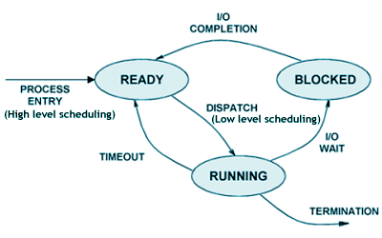
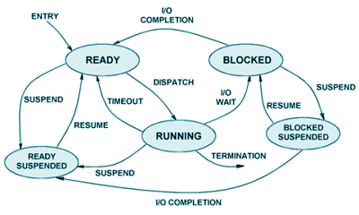
Notes:
Long-term (high-level) scheduling
Short-term (low-level) scheduling

Slide 67
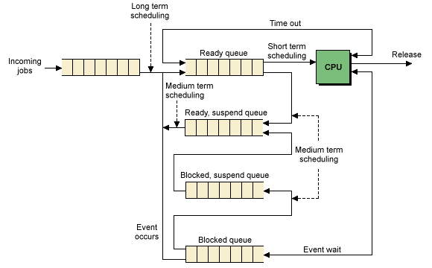

Slide 68

Multi-process Architecture – Chrome Browser
Many web browsers ran as single process (some still do)
If one web site causes trouble, --------------- ?
What browser? My browser? Is my browser out of date?
https://www.whatismybrowser.com/

Slide 69
Multi-process Architecture – Chrome Browser
Google Chrome Browser is multiprocess with 3 different types of processes:
Browser process manages user interface, disk and network I/O
Renderer process renders web pages, deals with HTML, Javascript. A new renderer created for each website opened
Runs in sandbox restricting disk and network I/O, minimizing effect of security exploits
Plug-in process for each type of plug-in

Slide 70
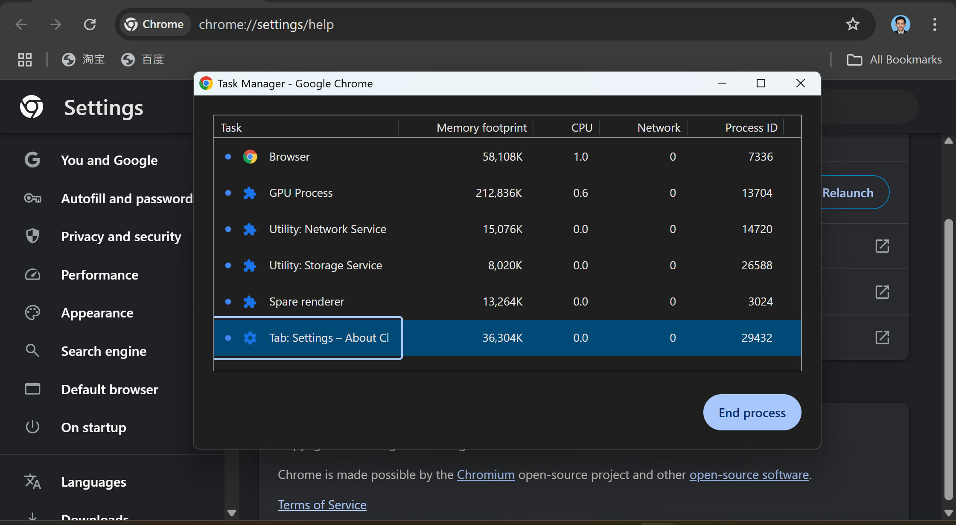

Slide 71
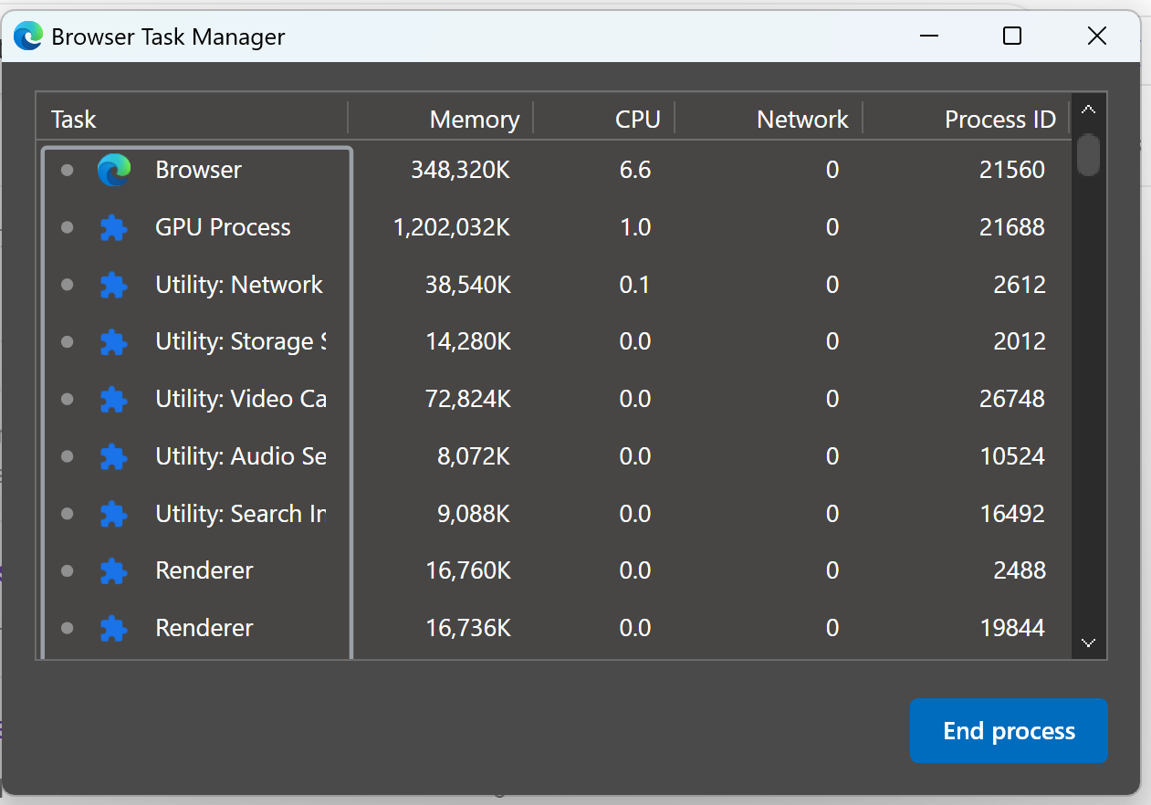

Slide 72
THREE MAJOR ACTIVITIES OF AN OPERATING SYSTEM IN REGARD TO MEMORY MANAGEMENT
Operating System has following three major activities in regard to memory management.
Keep track of which part of memory are currently being used and by whom.
Decides which processes are to be loaded into memory when memory space becomes available.
Allocate and de-allocate memory space as needed.

Slide 73
THREE MAJOR ACTIVITIES OF AN OPERATING SYSTEM IN REGARD TO SECONDARY STORAGE MANAGEMENT
Operating System has following three major activities in regard to secondary storage management
Free space management
Storage management
Disk Scheduling

Slide 74
SCHEDULING QUEUES
As processes enter the system, they are put into a job queue, which consists of all processes in the system.
Ready Queue
The processes that are residing in main memory and are ready and waiting to execute are kept on a list called the ready queue.
Device Queue
Suppose the process makes an I/O request to a shared device , such as printer. Since there are many processes in the system, the printer may be busy with the input/output request of some other process. The process may have to wait for the printer. This list of processes waiting for a particular I/O device is called device queue.

Slide 75
WHICH EVENTS COULD OCCUR WHEN A PROCESS IS ALLOCATED THE CPU AND IS EXECUTING
When a process is executing , then following events can occurs.

Slide 76
WHICH EVENTS COULD OCCUR WHEN A PROCESS IS ALLOCATED THE CPU AND IS EXECUTING
When a process is executing , then following events can occurs.
The process could issue an I/O request and then be placed in an I/O queue.
The process could create a new sub-process and wait for the sub-process’s termination.
The process could be removed by force from the CPU, as a result of an interrupt, and be put back in the ready queue.

Slide 77
SCHEDULERS
There are three types of schedulers in Operating System
Long Term Scheduler (or job scheduler)
selects which processes should be brought into the ready queue. New state to ready state.
Short Term Scheduler (or CPU Scheduler)
selects which process should be executed next and allocates CPU. Ready state to running state.
Medium Term Scheduler (or swapper)
responsible for suspending and resuming the processes. Main memory to Secondary memory.

Slide 78
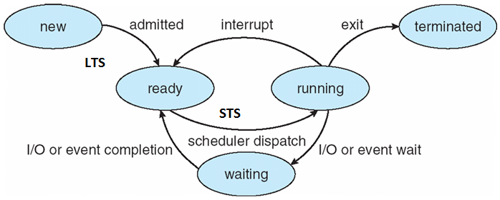
Process State Diagram

Slide 79
Degree of Multiprogramming
The no. of processes present in the main memory at any point of time is called degree of multiprogramming.
Long Term Scheduler controls the degree of multiprogramming.
LTS should select the good combination of CPU bound and I/O bound Process in order to get good throughput.
If more CPU bound Process then CPU utilization more and throughput low. Does everyone understand this concept??

Slide 80
CPU-bound Processes
A CPU-bound process is one that primarily requires a lot of CPU time to complete its tasks.
These processes spend most of their time performing computations, calculations, or executing algorithms.
Examples include tasks like video encoding, scientific simulations, and data processing tasks.
If there are too many CPU-bound processes in a system, it can lead to high CPU utilization but may result in lower overall throughput if they do not frequently yield control (i.e., they do not allow other processes to run).

Slide 81
I/O-bound Processes
An I/O-bound process, on the other hand, is one that spends more time waiting for input/output operations to complete rather than using the CPU.
These processes are often dependent on reading from disk drives, network operations, or other input/output devices.
Examples include web servers, database queries, and file transfers.
If there are many I/O-bound processes, the system can handle more tasks effectively because these processes often yield control while waiting for I/O operations.

Slide 82
I/O-bound process
Spends more time doing I/O than computations, short CPU bursts
CPU-bound process
Spends more time doing computations; very long CPU bursts
CPU Burst
a time period during which the process wants to continuously run in CPU.

Slide 83
Week#07 Monday’s Lecture

Slide 84
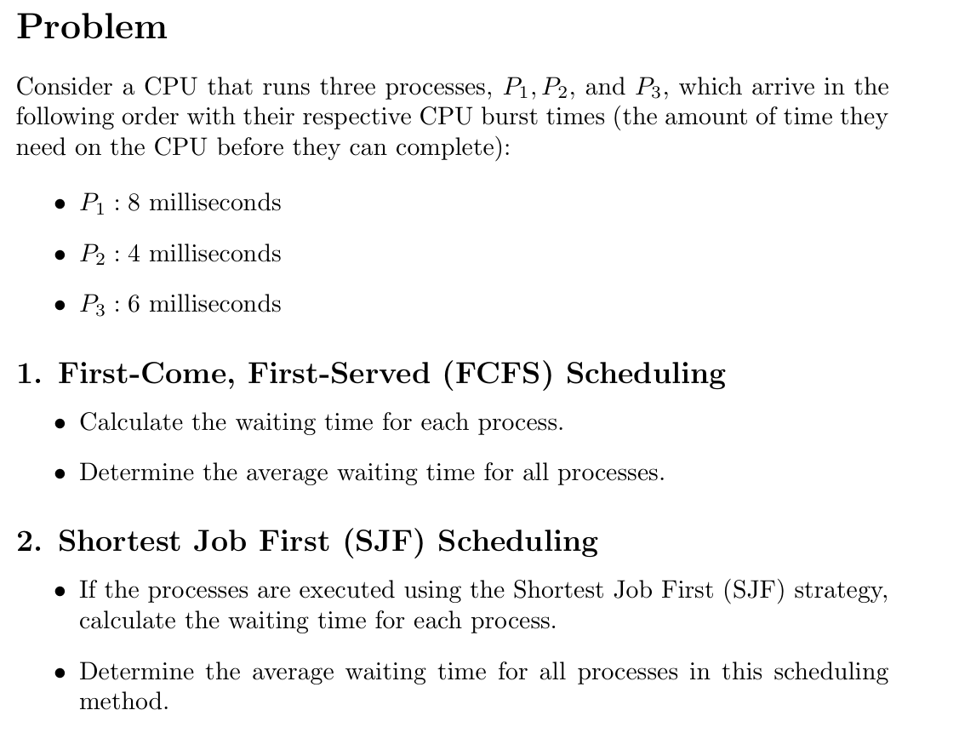

Slide 85
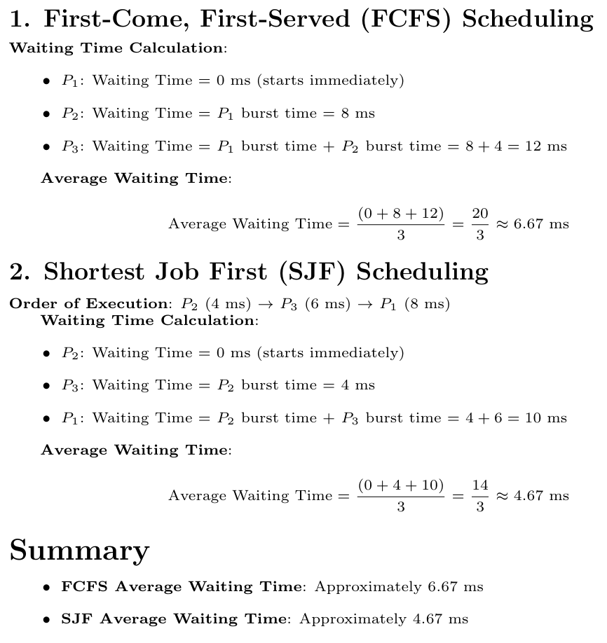

Slide 86
MCQs
What is the primary purpose of the "Kernel Mode" in an operating system?
a: To execute user-level applications
b: To display user instructions
c: To run system-level tasks and interrupt handlers
d: To manage hardware resources
In a context switch, which of the following is NOT typically saved and restored?
a: Program counter (PC)
b: Stack pointer (SP)
c: General-purpose registers
d: Cache memory
Notes:
Source:-Virtual Labs

Slide 87
MCQs
What is the role of the Process Control Block (PCB) in an operating system?
a: To display user instructions
b: To manage hardware resources
c: To store details of a process during its execution
d: To execute interrupt handlers
Which component of a CPU is responsible for fetching and decoding instructions?
a: Control unit
b: Arithmetic logic unit (ALU)
c: Memory Unit
d: Input/Output Unit (IOU)

Slide 88
MCQs
What is the purpose of a timer interrupt in a multitasking operating system?
a: To synchronize processes
b: To initiate a context switch
c: To handle user input
d: To allocate memory
Which of the following is NOT typically a part of the Process Control Block (PCB)?
a: Process ID
b: Program counter (PC)
c: Cache memory
d: Register values
What is the primary purpose of a context switch in an operating system?
a: To save power
b: To restart the computer
c: To allow multitasking and switch between processes
d: To update system documentation

Slide 89
Correct Answers
C
In the kernel mode, the operating system manages system-level tasks such as memory management, device drivers, and interrupt handling. For example, it handles hardware interrupts generated by devices like disk drives or network cards
D
During a context switch, the CPU typically saves and restores the program counter (PC), stack pointer (SP), and general-purpose registers. Cache memory is not saved and restored because it is part of the CPU's internal architecture and not directly related to the process state.
C
the PCB stores details of a process during its execution. For example, it stores the process state, such as the program counter (PC), stack pointer (SP), and general-purpose registers.

Slide 90
Correct Answers
A
The control unit is responsible for fetching and decoding instructions.
B
A timer interrupt is used to enforce time-sharing among multiple processes in a multitasking operating system. When a timer interrupt occurs, the system can perform a context switch to allow another process to execute, ensuring fair CPU time allocation.
C
Simply, PCB does not store cache memory
C
A context switch is used to allow multitasking and switch between processes.

Slide 91
3.4 Inter Process Communication
Cooperating Processes
Processes within a system may be independent or cooperating
Independent process cannot affect (or be affected) by the execution of another process
Cooperating process can affect (or be affected) by the execution of another process
There are several reasons for providing an environment that allows process cooperation: - Advantages of process cooperation
Information sharing
Computation speed-up
Modularity (application will divided into modules/sub tasks)
Convenience (may be better to work with multiple processes)

Slide 92
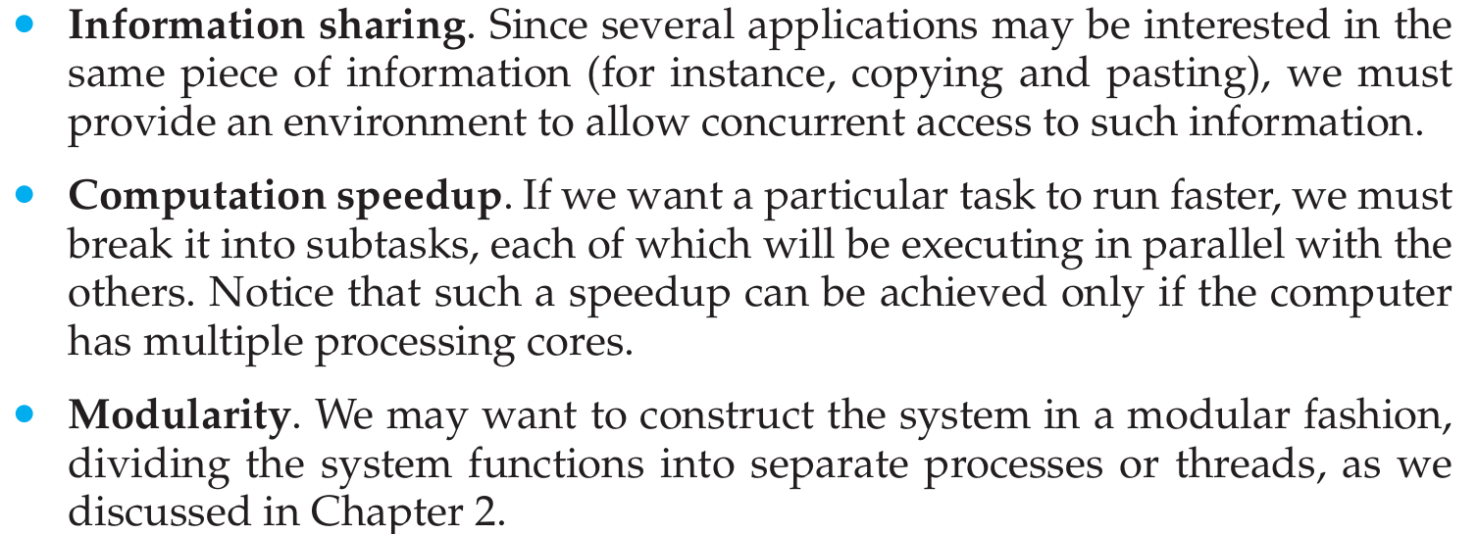

Slide 93
3.5 Inter Process Communication(IPC) Mechanisms
Cooperating process require a facility/mechanism for interprocess communication(IPC)
There are two basic mechanism provided by most systems
1. Shared Memory
2. Message Passing

Slide 94
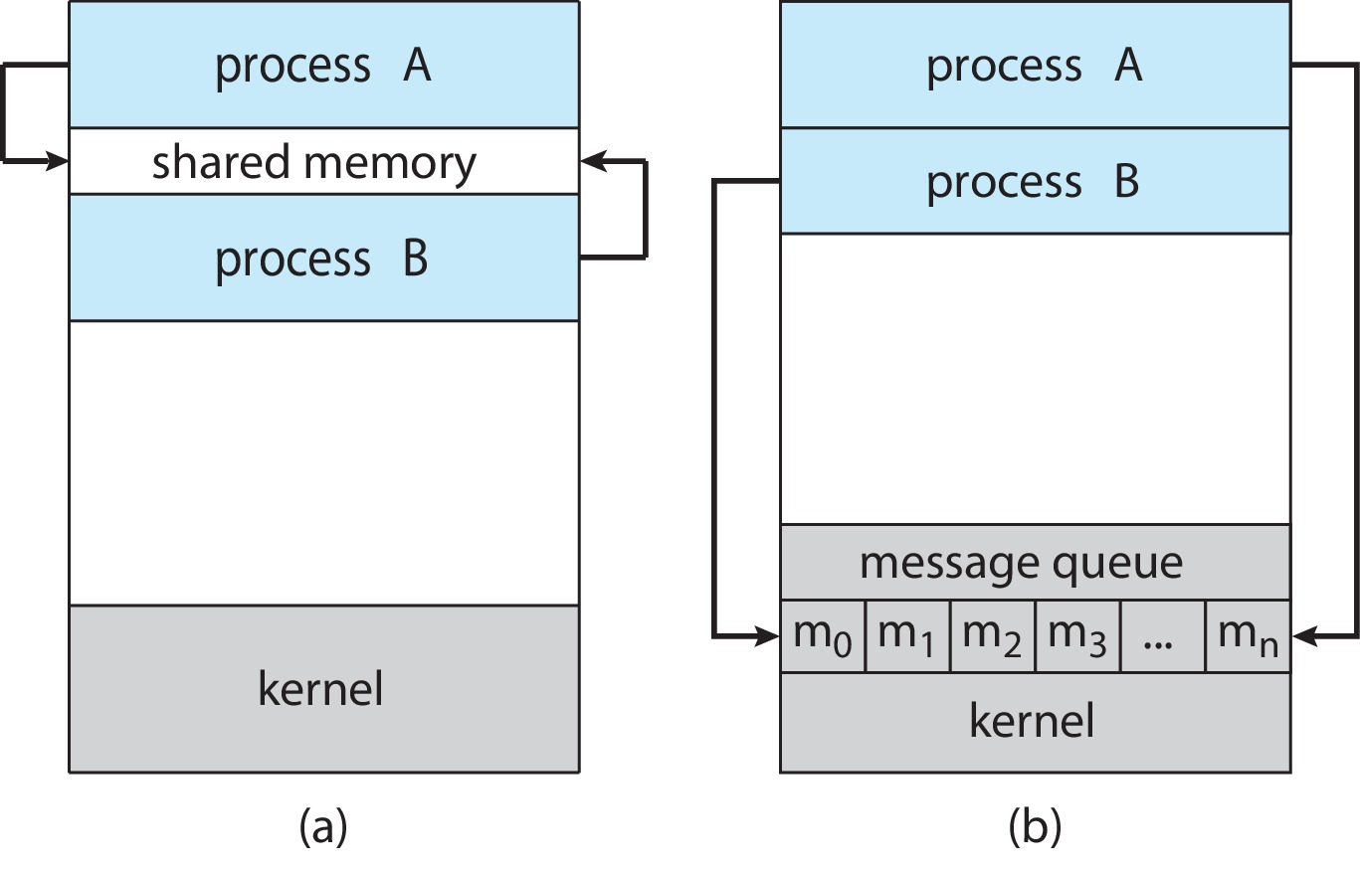
Communications Models
Inter Process Communication(IPC) Mechanisms
(a) Shared memory. (b) Message passing.

Slide 95
Shared Memory IPC Mechanism
A region of shared memory is established between (among) two or more processes
Establisment of that shared region is done via the help of the operating system kernel
Then, processes can read and write shared memory region (segment) directly as ordinary memory access (like they are accessing memory variables directly without kernel help)

Slide 96
Recommended reading
Read 3.4 and 3.5 now quickly to summarize the concepts

Slide 97
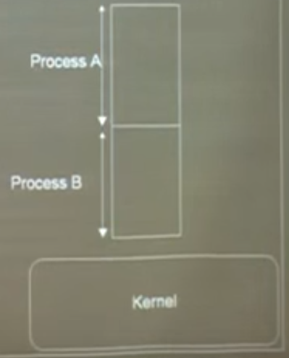
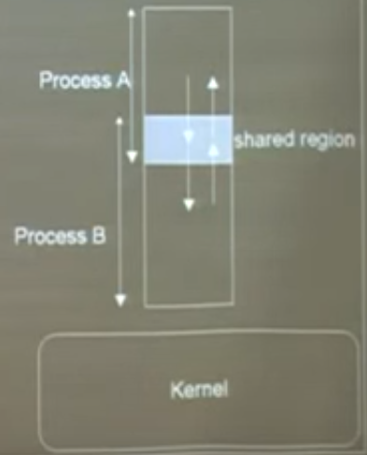
Shared Memory IPC Mechanism
Can you identify any possible issues ?

Slide 98
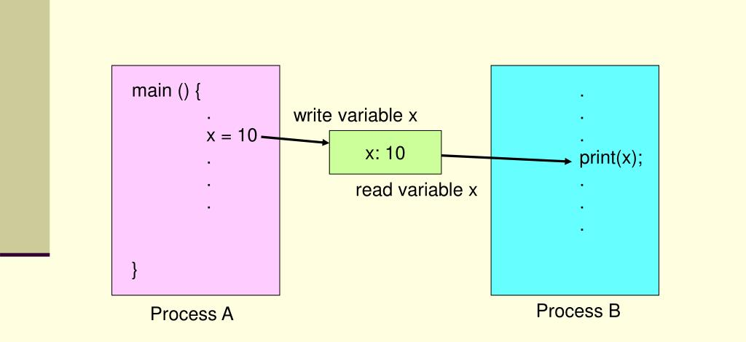
Shared Memory IPC Mechanism

Slide 99
Shared Memory IPC Mechanism
To illustrate the use of the shared memory IPC mechanism, a general model problem, called producer-consumer problem, can be used.
The issues with PC are Race Condition, Busy Waiting and No Mutual Exclusion

Slide 100
Producer and Consumer problem
The Producer and Consumer problem is a classic synchronization problem in operating systems and concurrent programming.
It describes a scenario where one or more producers generate data and put it into a buffer, and one or more consumers take data from the buffer.
The key challenge is ensuring that data is produced and consumed without causing conflicts (such as accessing the buffer when it's full or empty).

Slide 101
Race Condition
Both processes modify counter concurrently → corrupts its value.
Example: Producer and consumer simultaneously increment/decrement counter, leading to lost updates.

Slide 102
Busy Waiting
Wastes CPU cycles while waiting (while (counter == BUFFER_SIZE)).
No Mutual Exclusion
Critical sections (counter++, counter--, buffer access) lack protection

Slide 103
Shared Memory IPC Mechanism
Producer-consumer problem
Considering, we have a producer, a consumer and data is sent from producer to consumer.
unbounded-buffer places no practical limits on the size of the buffer
Bounded-buffer assumes that there is fixed buffer size

Slide 104
Producer-Consumer Problem
Paradigm for cooperating processes:
producer process produces information that is consumed by a consumer process
Two variations:
unbounded-buffer places no practical limit on the size of the buffer:
Producer never waits
Consumer waits if there is no buffer to consume
bounded-buffer assumes that there is a fixed buffer size
Producer must wait if all buffers are full
Consumer waits if there is no buffer to consume

Slide 105
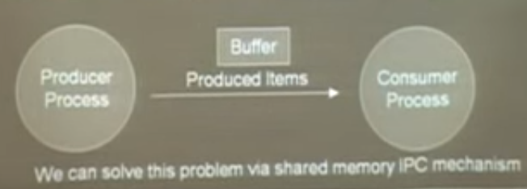
Producer-Consumer Problem

Slide 106
Producer
while (true) { /* produce an item in next produced */
while (counter == BUFFER_SIZE)
; /* do nothing */
buffer[in] = next_produced;
in = (in + 1) % BUFFER_SIZE;
counter++;
}

Slide 107
Consumer
while (true) {
while (counter == 0)
; /* do nothing */
next_consumed = buffer[out];
out = (out + 1) % BUFFER_SIZE;
counter--;
/* consume the item in next consumed */
}

Slide 108
Producer (server), Consumer (client)
Considering, a webserver produces (that is, provides) web content such as HTML files and images, which are consumed (that is, read) by the client web browser requesting the resource.

Slide 109
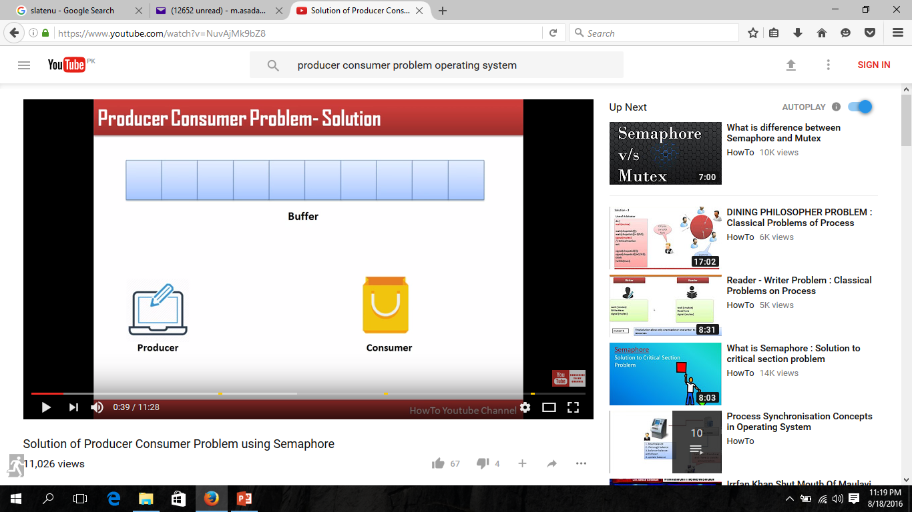
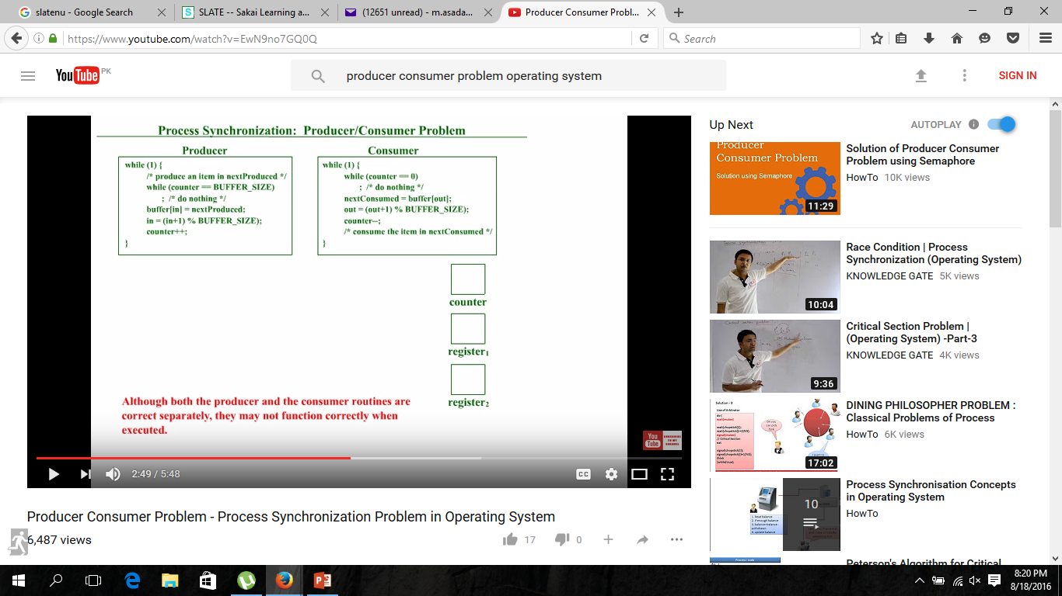
Producer-Consumer Problem
Server
Client

Slide 110
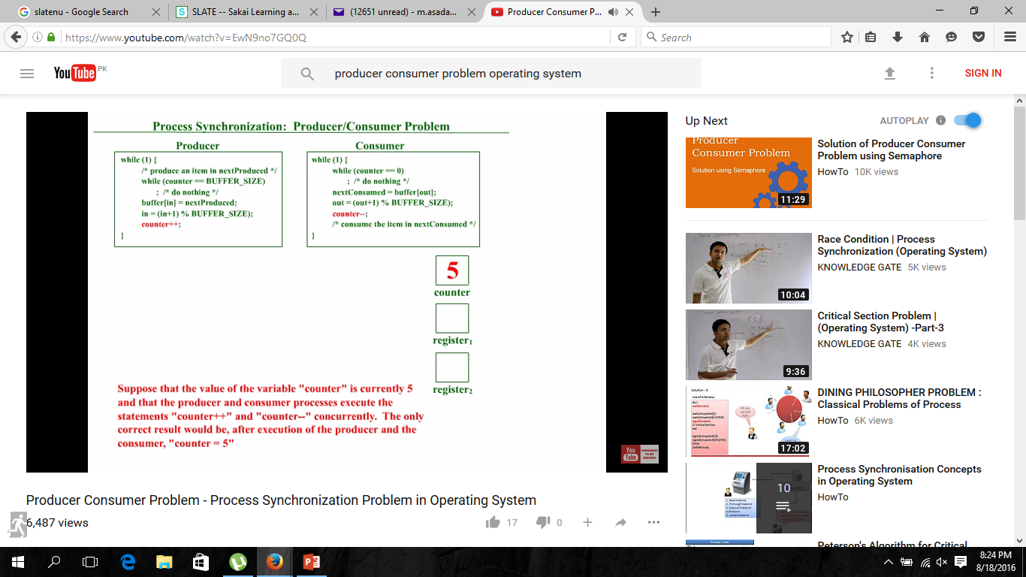
Producer-Consumer Problem

Slide 111
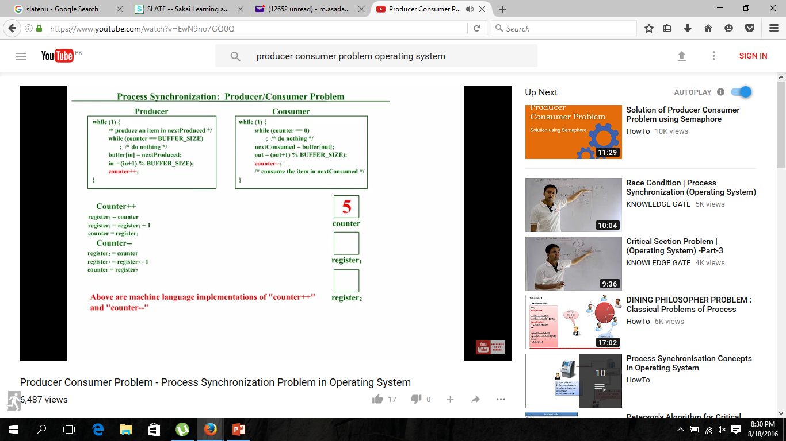
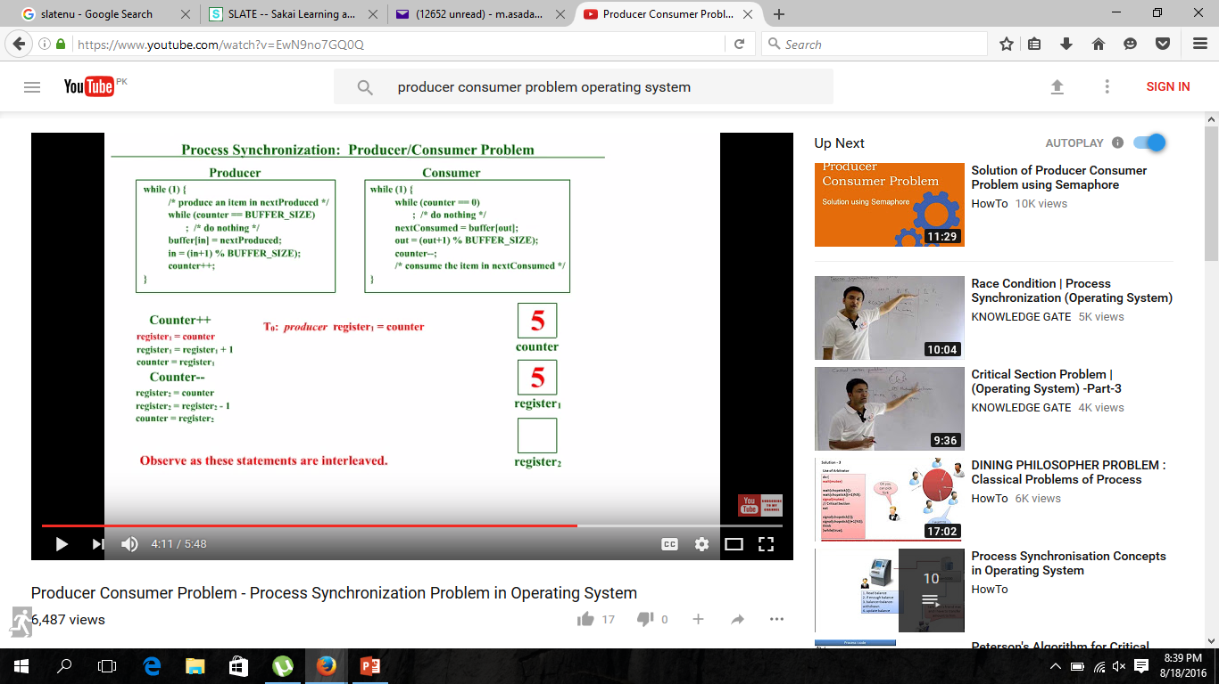



Slide 112
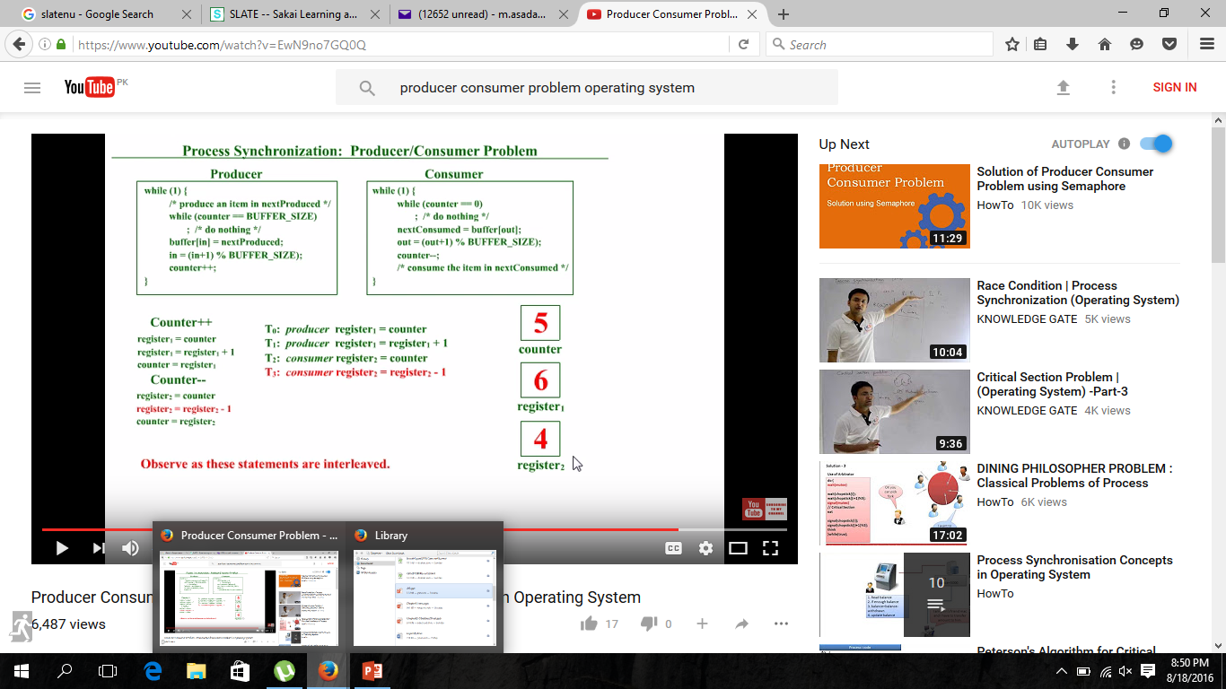



Slide 113
3.6 IPC in Message-Passing Systems
Mechanism for processes to communicate and synchronize their actions
This IPC facility provides two operations:
Send (message)- message size fixed or variable
Receive (message)
If P and Q wish to communicate, they need to:
establish a (logical ) communication link between them.
Exchange messages via send/receive

Slide 114

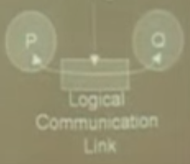
Message Passing IPC Mechanism

Slide 115
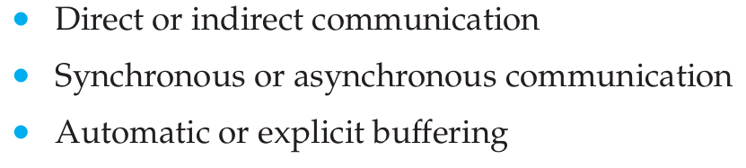
Logical issues with message passing

Slide 116
Direct Communication
Each process wanting to communicate must explicitly name the recipient or sender of communication.
send (destinatination-process P, message) – send a message to process P
receive(source-process Q, message) – receive a message from process Q
Properties of a direct communication link
Links are established automatically
Link is associated with exactly one pair of communicating processes
Between each pair there exists exactly one link
The link may be unidirectional, but is usually bi-directional

Slide 117
Indirect Communication
Messages are directed and received from mailboxes
Each mailbox has a unique id
Processes can communicate only if they share a mailbox
Properties of an indirect communication link
Link established only if processes share a common mailbox
A link may be associated with many processes
Each pair of processes may share several communication links
Link may be unidirectional or bi-directional

Slide 118
Indirect Communication
Operations
create a new mailbox
send and receive messages through mailbox
delete a mailbox
Primitives are defined as:
send(A, message) – send a message to mailbox A
receive(A, message) – receive a message from mailbox A

Slide 119
Synchronization
Message passing may be either
Blocking (send, receive), or
Non-blocking (send, receive)

Slide 120
Blocking is considered synchronous(occuring at same time)
Blocking send -- the sender is blocked until receiving process does a corresponding read
Blocking receive -- the receiver is blocked until a message is sent for it to receive
Non-blocking is considered asynchronous(not occuring at same time)
Non-blocking send -- the sender sends the message and continues
Non-blocking receive -- the receiver receives:
A valid message, or
Null message

Slide 121
Buffering in Message-Passing
Messages exchange by communicating processes reside in a temporary queue.
Queue implemented in one of three ways
Zero capacity – queue length 0
No messages wait. Sender must wait until receiver receive the message
Bounded capacity – finite length queue
Messages can be queued as long as queue not full, otherwise sender has to wait if queue full
Unbounded capacity – infinite length
Any number of messages can be queued ,sender never waits

Slide 122
3.7 Examples of IPC Systems (Self coverage)

Slide 123
End of Chapter 3 but it’s not end actually

Slide 124
Communications in Client-Server Systems
Sockets
Remote Procedure Calls

Slide 125
Sockets
A socket is defined as an endpoint for communication
Concatenation of IP address and port – a number included at start of message packet to differentiate network services on a host
The socket 161.25.19.8:1625 refers to port 1625 on host 161.25.19.8
Communication consists between a pair of sockets
All ports below 1024 are well known, used for standard services
Special IP address 127.0.0.1 (loopback) to refer to system on which process is running

Slide 126
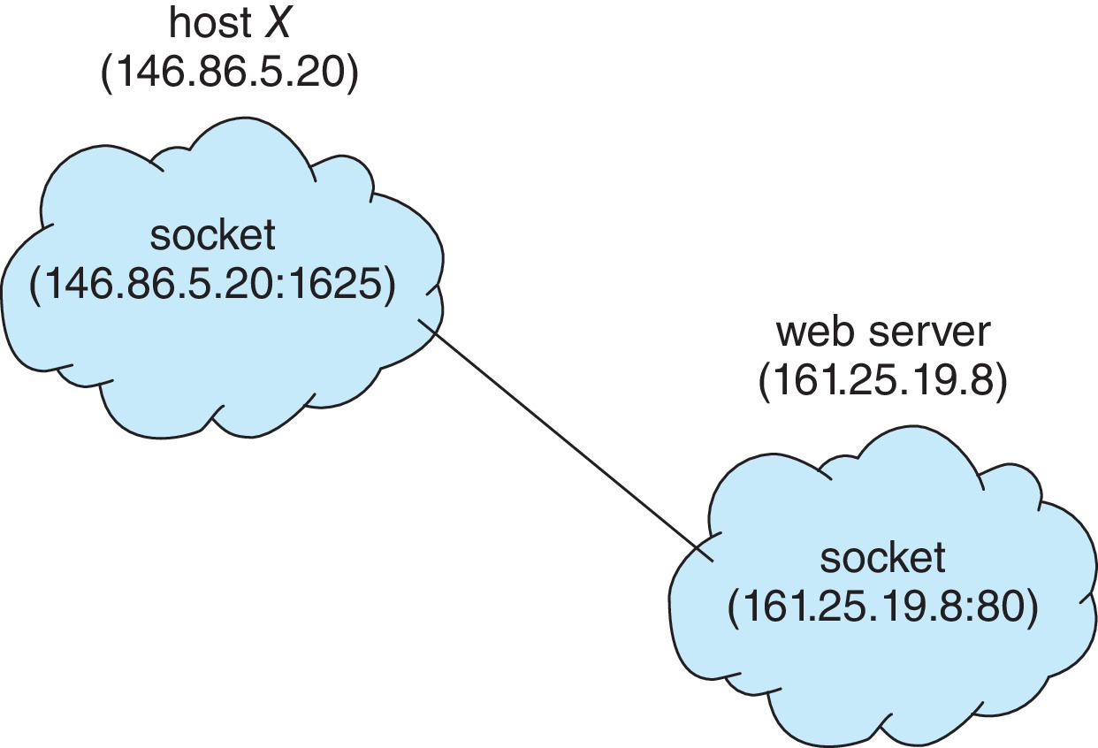
Socket Communication

Slide 127
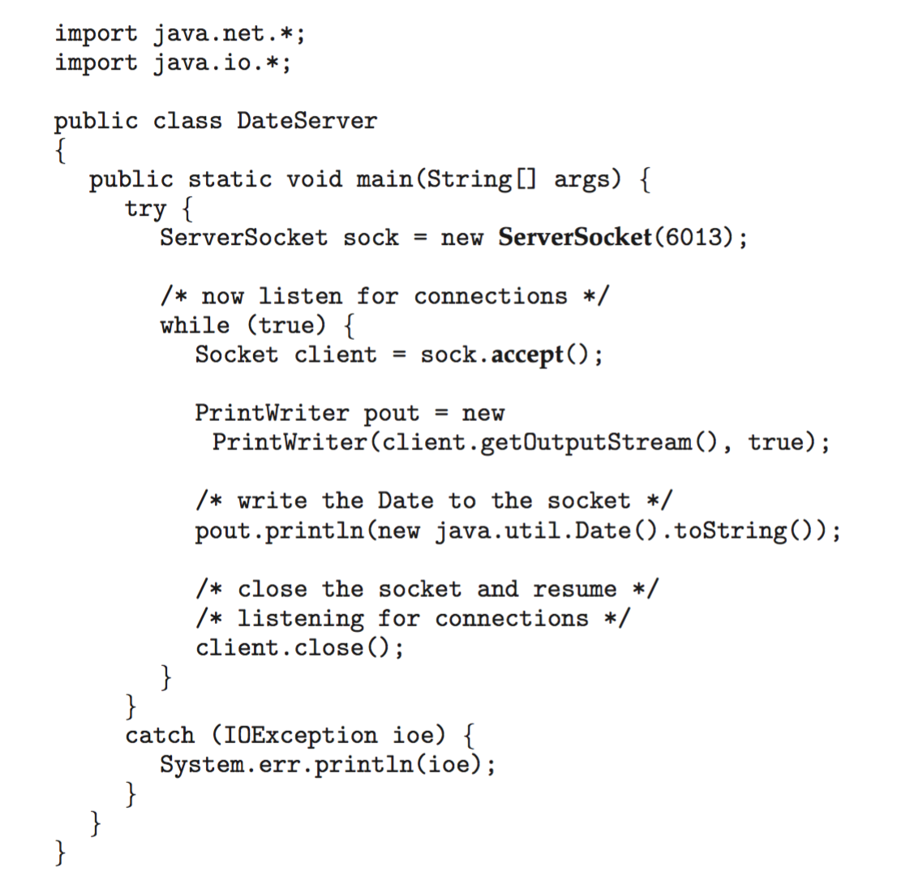
Sockets in Java
Three types of sockets
Connection-oriented (TCP)
Connectionless (UDP)
MulticastSocket class– data can be sent to multiple recipients
Consider this “Date” server in Java:

Slide 128
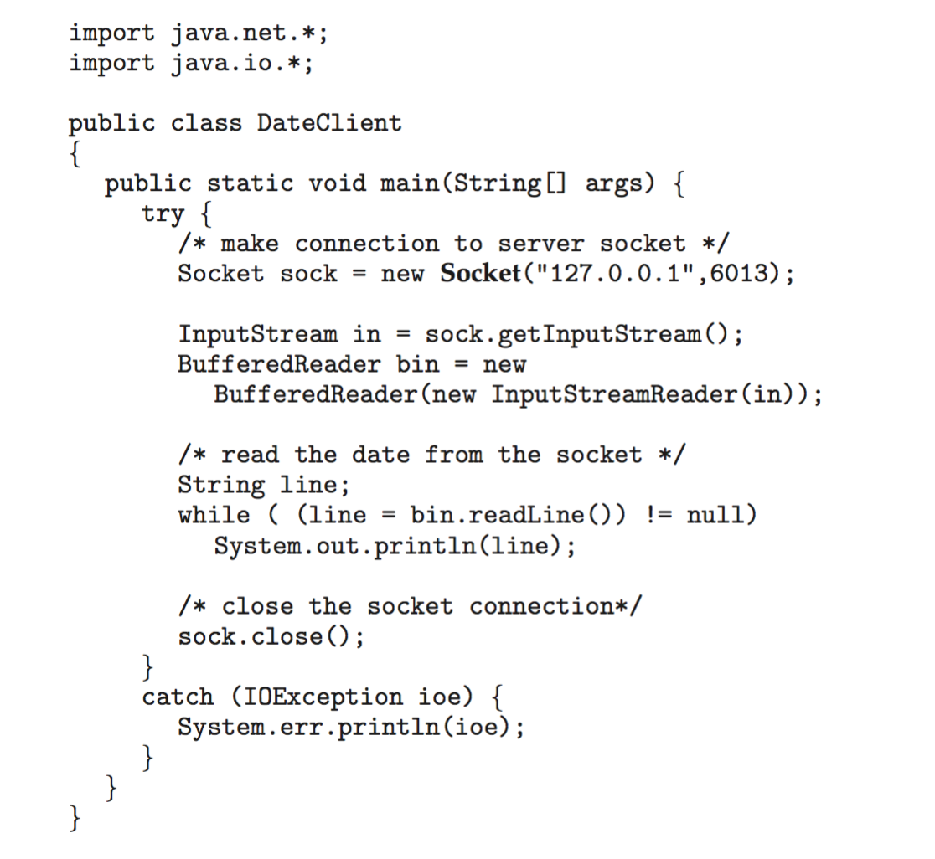
Sockets in Java
The equivalent Date client

Slide 129
Remote Procedure Calls
Remote procedure call (RPC) abstracts procedure calls between processes on networked systems
Again uses ports for service differentiation
Stubs – client-side proxy for the actual procedure on the server
The client-side stub locates the server and marshalls the parameters
The server-side stub receives this message, unpacks the marshalled parameters, and performs the procedure on the server
On Windows, stub code compile from specification written in Microsoft Interface Definition Language (MIDL)

Slide 130
Remote Procedure Calls (Cont.)
Data representation handled via External Data Representation (XDL) format to account for different architectures
Big-endian and little-endian
Remote communication has more failure scenarios than local
Messages can be delivered exactly once rather than at most once
OS typically provides a rendezvous (or matchmaker) service to connect client and server

Slide 131
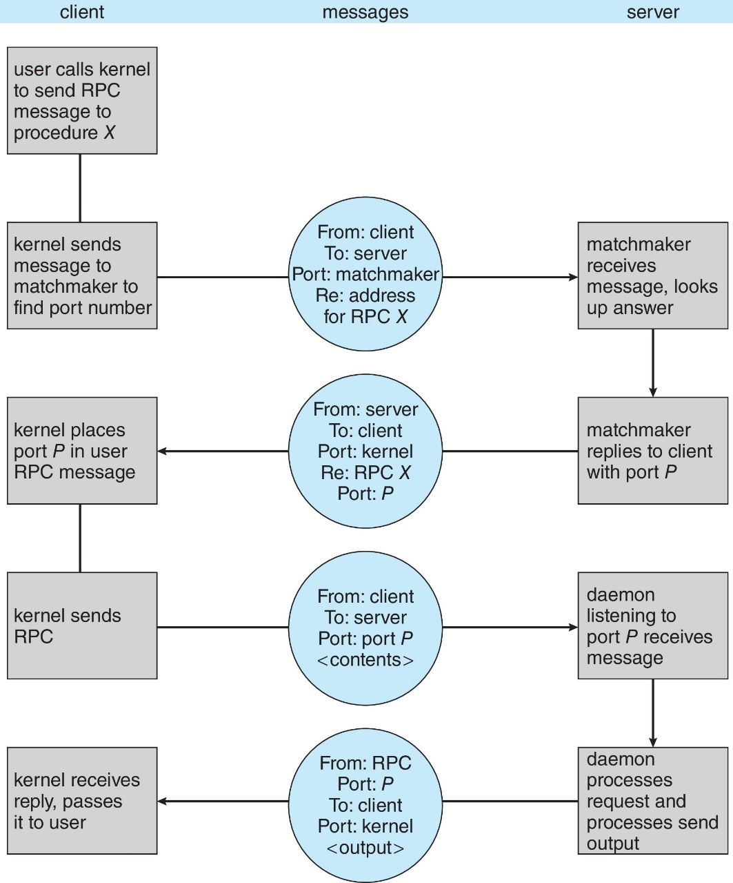
Execution of RPC

Slide 132
End of Chapter 3

